Slide 1
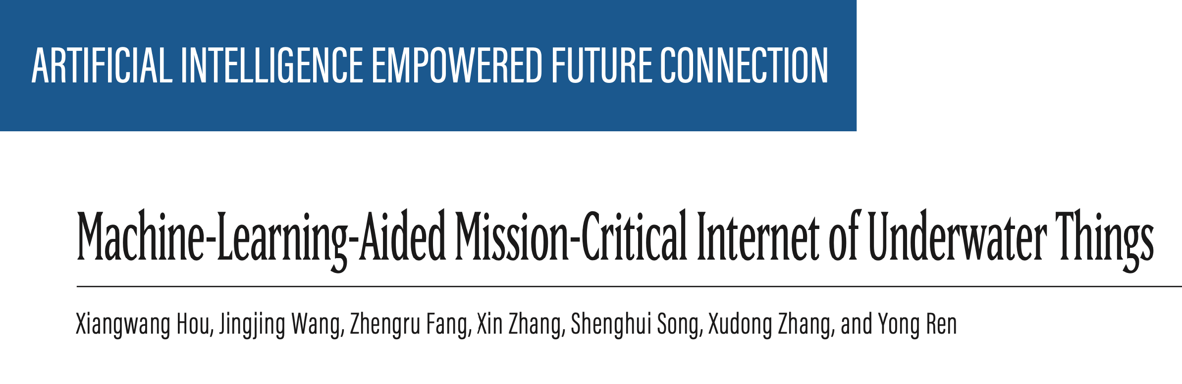

Slide 2
MachIne-LearnIng-AIded MIssIon-CrItIcal Internet of Underwater ThIngs
Berk Barış Kara - 18253007

Slide 3
Makalenin ana konusu
Çeşitli ilgi çekici IoUT uygulamaları, denizcilik faaliyetlerine yeni bir çağ getiriyor. Bununla birlikte, okyanus deprem tahmini, su altı navigasyonu vb. dahil olmak üzere, misyon açısından kritik bazı denizcilik faaliyetleri, mevcut IoUT mimarileri ve ilgili teknikler üzerinde önemli bir zorluk teşkil etmektedir.
Bu nedenle, bu makalede, bu amansız denizcilik faaliyetlerini güçlendirmek için, kritik görev IoUT kavramını tasarlıyor ve temel özelliklerini ve zorluklarını vurgululanmaktadır.
Bazı Machine Learning algoritmalarından da faydalanmanın doğru olacağını düşünmüşlerdir.
Ayrıca, kritik görev IoUT'nin zor gereksinimlerini karşılamak için, bilgi algılama, iletim ve işleme açısından gelecekteki bir deniz ağı mimarisi ve makine öğrenimi destekli temel teknikler önerilmektedir. güvenilir ve düşük gecikmeli sualtı bilgi aktarımına ilişkin son araştırmamızı sunuyoruz. Son olarak, gelecekteki kritik görev IoUT için açık sorunları ve potansiyel araştırma eğilimlerini sağlanmaktadır.

Slide 4
Why we need Iout (underwater thıngs) ?
With the aid of maritime satellites, we can fulfill wide-coverage and high-precision monitoring and reliable communications on the surface of the ocean. But, I don’t say same thing for on underwater.
Underwater communicate very hard than surface of the ocean.
However, underwater information acquisition is a significantly difficult problem due to the complex underwater environments and limited technologies.

Slide 5
What ıs the solve of communıcate underwater?
We can use IoUT with huge sensors and equipment for monitoring and communicate.
Recently, the Internet of Underwater Things (IoUT) , relying on massive underwater sensors and equipment, provides a feasible approach for sensing, monitoring, and driving underwater environments as well as objects. Based on it, we can build a “smart ocean” characterized by transparency, controllability, and intelligence.

Slide 6
IOUT ıs scalable?
Yeah , exactly IOUT can good performance with minimum price.
IOUT main purpose is « SMART OCEAN »

Slide 7
What ıs the mIssIon-crItIcal IoUT?
Advanced IoUT applications, for instance, ocean earthquake fore-casting, underwater navigation, underwater moving target detection, which can be referred to as mission-critical IoUT.
Nevertheless, with the further development of marine exploration, more requirements are put forward for advanced IoUT applications, for instance, ocean earthquake forecasting, underwater navigation, underwater mov- ing target detection, which can be referred to as mission-critical IoUT. Unlike the aforementioned IoUT applications, the so-called mission-critical IoUT applications have stringent requirements, including reliability, latency, timeliness, and so on. If the mission-critical IoUT applications’ requirements are not met, it may lead to ineffective decision making and error control, and even systemic disasters. Although mission-critical IoUT has a promising prospect, the complex underwater environment poses several obstacles to its devel- opment, specifically the following.

Slide 8
Let dıvıde by 3 ımportant pıece of underwater commınıcate
information Sensing: Checks if the incoming information is correct. so give decides whether it is valid or not. But a new approach is required as IoT devices can be easily damaged.
Information Transmission: Information transmission is one of the most challenging targets in complex underwater environments cause of the uneven temperature, salinity, static pressure, and other hydrological characteristics of seawater, and the time-varying ocean currents and irregular under- water topography lead to serious interference, which turns various mature communication methods (e.g., radio communication) powerless. Achieving reliable and timeliness-ensuring infor- mation transmission requires us to make a brand new design.

Slide 9
Information Processing: For critical tasks, time is a very important parameter, so it is expected that the data will be processed as soon as possible, but this data is so large that most of the information in it is unnecessary. As a solution, efficient data processing should be required. Which leads us to a new underwater architecture design.

Slide 10
New archItecture desIgn ON UNDERWATER THINGS
This new architecture , future system architecture of IoUT, and emphasized the crucial roles of cloud computing based and fog computing in IoUT data processing.
Focusing on the problem of underwater information transmission proposed a sender-receiver role-based scheduling protocol for energy-aware scheduling relying on spatial-temporal reuse.
Wang designed a UAV assisted underwater information collection framework based on receiving nodes on the water surface and UAVs as intermediate relays to transmit sensor data from IoUT devices to a remote onshore data processing center.
for IoUT, characterized by low energy consumption and adaptability to the marine environment.

Slide 11
future MArItIMe network ArchItecture And key technIques for MIssIon-crItIcAL Iout future MArItIMe network ArchItecture -The future marItIme network can collaborate well wIth space-aIr networks and terrestrIal networks to provIde relIable and tImely InformatIon servIces for mIssIon-crItIcal IoUT.

Slide 12
Layer of new network ArchItecture
Surface Layer: By deploying floating platforms (e.g., surface base stations, ships, and buoys on the sea surface), several communication systems, such as 3G/4G/5G/WiMAX, can be adopted to realize data backhaul link with seashore terres- trial networks [8]. Moreover, in the far-reach sea area, utilizing satellites to support data backhaul is also a possible approach via L/S/C/Ka/Ku-band. In addition, the automatic identification system (AIS), as an open data transmission system, has been widely accepted in maritime traffic control and surveillance networks to collaborate with the aforementioned cellular communication systems and satellite systems to form the future maritime network.

Slide 13
Underwater Layer:
Furthermore, due to the enormous observation areas, AUVs, submersible buoys, and submarines are widely adopted to implement dynamic and flexible data transmission, fusion, and near-real-time underwater processing. Obviously, optical-cable-based communication is not suitable, and the radio frequency communica- tion widely adopted in the terrestrial network can not transmit the collected data across the water with high reliability and data rate due to the great propagation loss underwater. Therefore, UAC and wireless optical communication are better choices.
Seabed Layer:
On the seabed, massive IoUT devices (e.g., cameras, sensors, detection equipment) are deployed at the bottom of the ocean to collect a large amount of valuable ocean data to realize underwater environment perception. These IoUT devices can realize collaborative per- ception and information aggregation via optical cable communication, magneto-inductive com- munication, as well as underwater acoustic communication (UAC).

Slide 14
Terrestrial Network: The terrestrial network mainly takes charge of three responsibilities. First, since several mission-critical IoUT services are employed on the seaside, such as smart seaport, orchestrating maritime and seashore communication infrastructures to support the mentioned sea-shore services, is suitable and reliable. Second, a large amount of collected ocean data needs to be transmitted to the ground control center for further analysis, and the seashore network can relay massive data at a high data rate. Finally, although a proportion of the collected data is processed in the maritime network, terrestrial cloud computing is needed to realize data mining and long-term data storage for some data-intensive applications and applications without real-time processing requirements.

Slide 15
Space-Air Network: UAVs and high-altitude platforms (HAPs, e.g., balloons), characterized by high flexibility, can act as relay nodes or information sink nodes to provide information reinforcement services and emergency access services. Although the limited resources and weak through- put of satellite systems make them unsatisfactory in undertaking high-rate transmission services, their strong global coverage and high security inspire us to employ them to exchange secret keys, schedule network resources, and so on.
Slowly but GLOBAL. Not a best choice for fast comminicate but have really huge GLOBAL network.

Slide 16
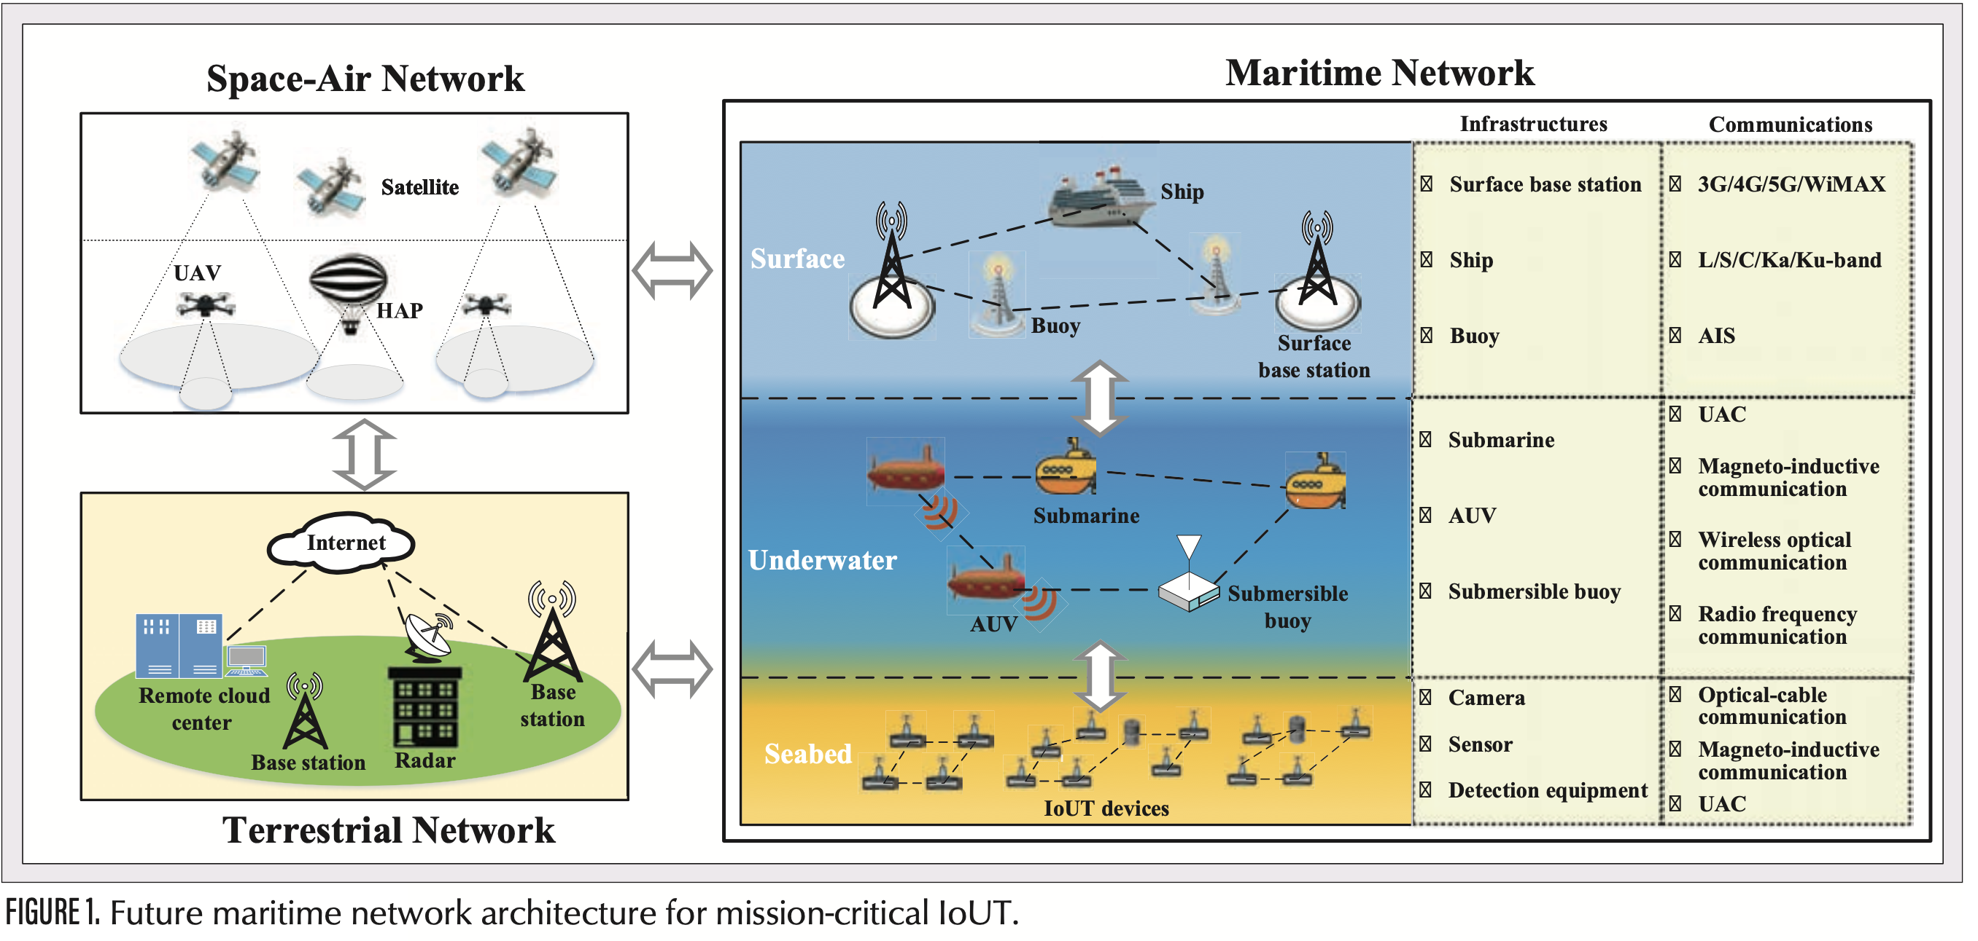

Slide 17
ML-AIded key technIques for MIssIon-crItIcAL Iout
Traditional network techniques relying on the deterministic method are no longer suitable for mission-critical IoUT, operating in complex underwater environments characterized by large scale, time variance, and sparsity. Therefore, we are motivated to employ ML to revolutionize network methodologies for satisfying the stringent requirements of mission-critical IoUT.

Slide 18
Fault-Tolerant IoUT Deployment Strategy:
IoUT devices are often deployed in harsh under- water environments, and ensuring uninterrupted and accurate information sensing is a significant but difficult issue. On one hand, the energy con- sumption of the IoUT device is limited, and it is generally impossible to charge the device or replace its depleted battery. Once the battery runs out, the device cannot continue to work. On the other hand, obstacles, antenna angles, signal interference, and malicious attacks can also lead to failure of an IoUT device. Therefore, fault-tolerant IoUT device deployment strategy is extremely necessary to meet the high-reliability demands of mission-critical IoUT. However, in complex underwater environments, numerous factors may lead to device error or failure. The relationship between these factors and the proba- bility of device failure are usually time-varying and nonlinear. It is difficult to derive a deterministic mathematical model. The deep neural network (DNN) , which has powerful inferring and data analysis capabilities using large amounts of histor- ical data, is a suitable method to cope with it. We can employ DNN to capture the nonlinear and dynamic relationship between complex environments and system failure probability to obtain a near-optimal IoUT deployment strategy.

Slide 19
Multi-Resource Data Fusion: Solely relying on single-type IoUT devices cannot accurately obtain the information about the observation object due to the limitations of observation ability, which may lead to wrong decision or control, causing inesti- mable losses in mission-critical IoUT. Moreover, the complex underwater environments, involving ocean currents, biological activities, and so on, may bring random interference on IoUT devices. Thus, the accuracy and robustness of the collected data are significantly weakened. Therefore, it is essential to realize the collaborative perception and data fusion of diverse sensor data, which can dramatically cope with imperfect raw data for obtaining reliable and accurate information. However, traditional data fusion strategies, mainly including evidential belief reasoning fusion (e.g., Dempster-Shafer theory), probabilistic fusion (e.g., Bayesian theory), and rough set-based fusion, appear to be powerless against the IoUT data fusion problems characterized by high-dimensionality and nonlinearity. ML is expected to bring new opportunities for data fusion. The characteristics and application scenarios of the ML-enabled multi-source data fusion strategies in mission-critical IoUT are summarized in Table 1.

Slide 20
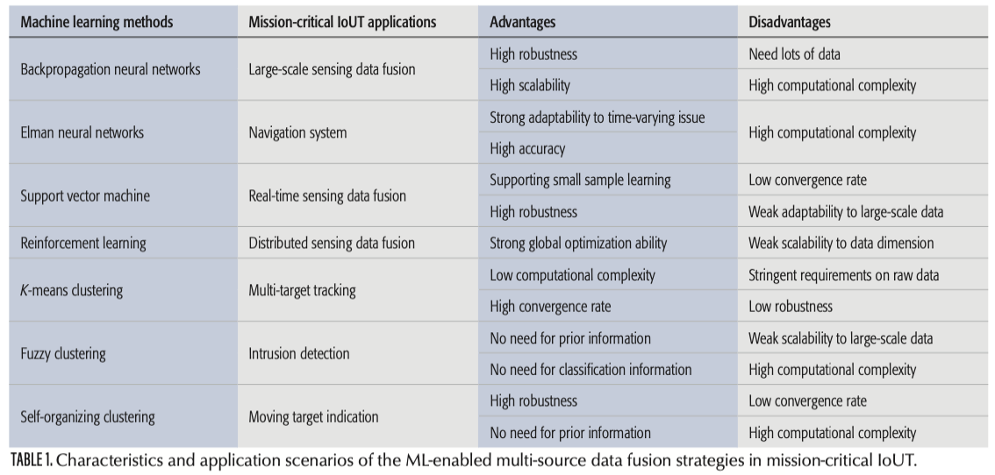

Slide 21
Multimodal Integrating Cooperative Communication: Due to severe multi-path interference, narrow available bandwidth, serious signal attenuation, and the Doppler effect of the underwater channel, underwater wireless communication has become one of the biggest problems restricting the development of mission-critical IoUT. At present, there are four recognized underwater wireless communication methods, including UAC, radio communication, wireless optical communication, mainly visible light communication (VLC) with the wavelength in 380∼40 nm, and magnetic -inductive communication. Their advantages and disadvantages are shown in (Table 2). We can see that none of them can solely meet the stringent transmission requirements of mission-critical IoUT. Hence, we are motivated to combine them to realize multimodal integrating cooperative com- munication. This means it can select different com- munication methods according to the different requirements for downlink and uplink channels, or use multiple communication methods simulta- neously to realize highly reliable redundant transmission. At present, one of the most competitive research trends of multimodal integrated cooperative communications is underwater opto-acoustic communication. Opto-acoustic communication has the advantages of both optical communication and acoustic communication to achieve high data rate and long-distance transmission. Obviously, efficient channel perception and intelligent decisions in the complex environment are key enablers for realizing multimodal integrated cooperative communication. Reinforcement learning , one kind of ML, characterized by dynamic-adaptive learning ability, can play a crucial role in dealing with multi-dimensional complex channel perception and intelligent decision making.

Slide 22
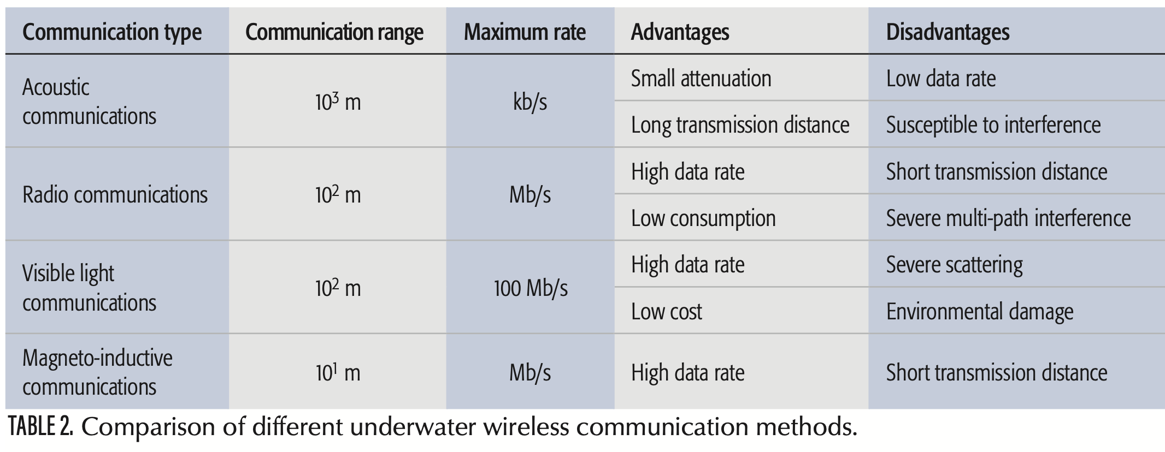

Slide 23
Multi-AUV-Assisted Cooperative Information Collection and Transmission: To address the difficulty in building fixed observation stations and information access stations in the vast and complex marine environment, using flexible AUVs to realize information collection and transmission has been widely accepted. Unlike non-mission-critical IoUT services that just balance the multi-AUV system’s cost and the average system performance, mission-critical IoUT makes stringent requirements on multi-AUV cooperation on a single task, even on a single time slot. Therefore, it motivates us to use fine-grained control of multi-AUV collaboration under the consideration of time-varying underwater environments, including path plan- ning, and collaborative information collection and transmission. However, on one hand, the control of AUV is significantly related to complex and time-varying underwater environments, which makes it difficult to establish an accurate dynamic model. On the other hand, scheduling multiple AUVs to realize efficient cooperation within the stringent service requirements is also significantly hard. Hence, we can employ reinforcement learning to realize time-varying environment perception and motion optimal control without a definite model, and further utilize swarm intelligence algorithms to perform efficient multi-AUV cooperation.

Slide 24
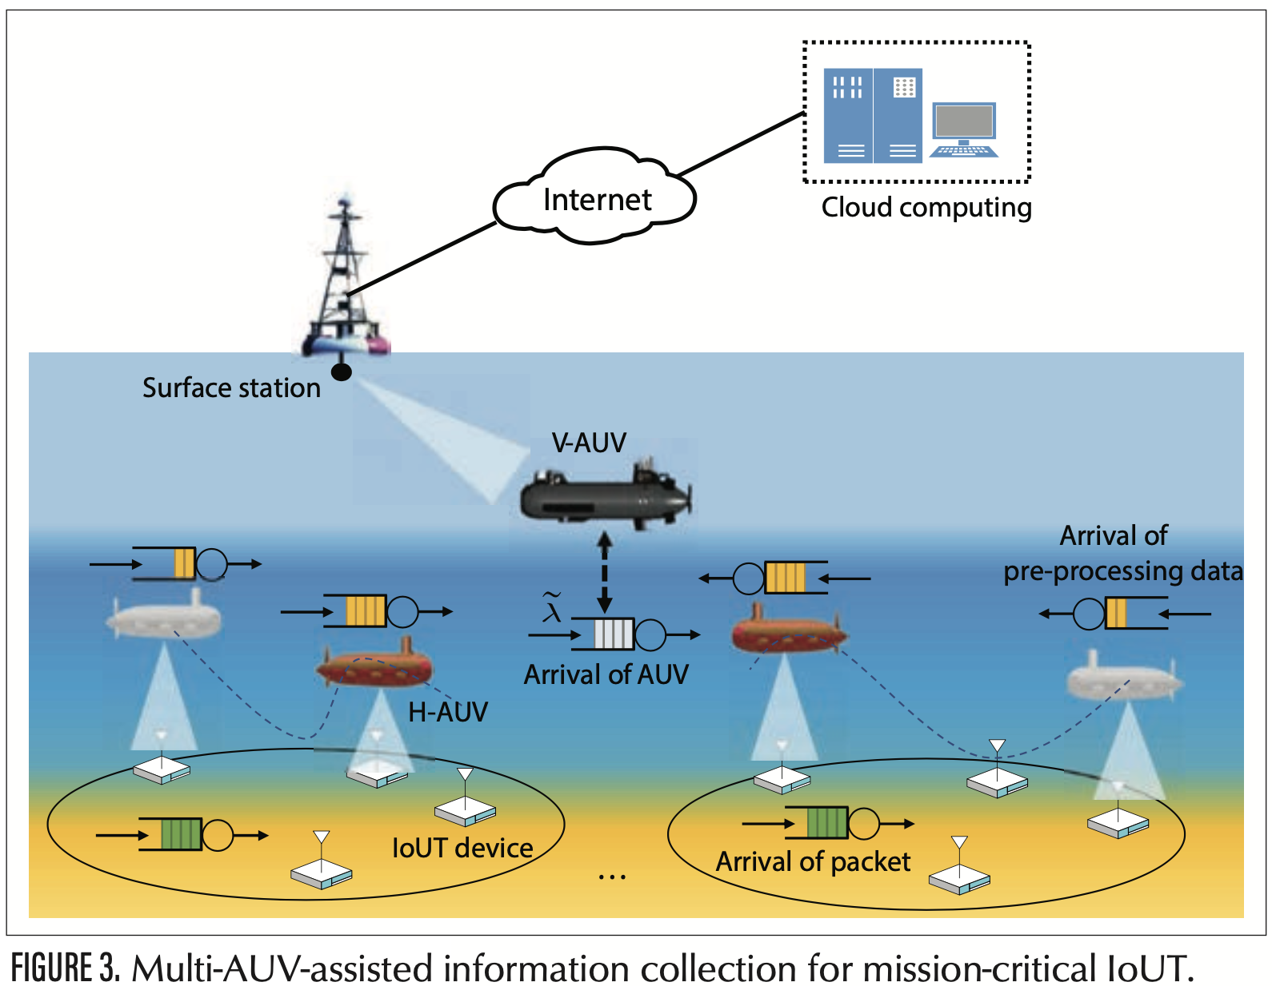

Slide 25
Reliable and Fast Processing:
Reliability-Oriented Distributed Edge Computing: The cloud-computing-based data processing approach plays an essential role in non-mission-critical IoUT applications. By aggregating the amount of data to the cloud center and digging out the valuable information hidden behind the large-scale data by data mining tech- nology, some marine activities, such as resource exploration and fish prediction, can be conducted well. However, it is not suitable for mission-critical IoUT due to the high transmission latency. The reason for the high transmission latency mainly includes two aspects. Specifically, on one hand, data from the IoUT devices to the cloud center is often over a long distance forwarded by many intermediate nodes. On the other hand, a significant portion of the collected raw data is useless, and transmitting them results in serious resource consumption and excessive latency. Therefore, we are motivated to introduce the concept of edge computing to provide low-latency com- puting services for mission-critical IoUT. AUVs1 and a floating platform, close to the data resources and with certain computing ability, can be seen as edge computing nodes to process the raw data at the edge of the network. In this way, on one hand, some mission-critical IoUT services are empowered. On the other hand, a large amount of useless data is preprocessed in the network edge, which can significantly reduce the amount of transmitted data and improve resource utilization. Furthermore, the excellent thermal con- ductivity of seawater can significantly release the power of the computing resources. Although edge computing can bring new opportunities to mission-critical IoUT, it should be noted that, dif- ferent from cloud computing with high reliability, the edge computing nodes (e.g., AUVs) face varying interference underwater. Therefore, it is essential to conceive a reliability-oriented adaptive-learning distributed cooperation strategy driven by ML.

Slide 26
Secure Distributed Edge Learning Framework: Maximizing the potential value of collected data under the limited resources, as well as with high security, is intensely important in mis- sion-critical IoUT, especially in some military scenarios. Therefore, an efficient and secure ML framework is urgently needed. Federated learning is a security-protected decentralized collaborative ML framework . Under the federated learning framework, each node trains its sub-model independently and only needs to interwork the encrypted sub-model parameters with the fusion node to achieve a convergent global ML model. By this means, under the premise of ensuring security and minimizing communication overhead, an effective model for digging out the potential value of the collected data can be derived. The realization for distributed edge federated learning in mission-critical IoUT is shown in (Fig. 2), which can be divided into four steps:
• Participants (referring to AUVs) train their own learning model, which can be considered as a sub-model of the global model, and send their encrypted sub-model parameters only to the fusion node (referring to floating platform).
• The fusion node performs parameter aggregation without any raw data from participants.
• The fusion node sends the updated global parameters to the participants.
• Participants update their respective sub-mod- els with the updated global parameters they receive.

Slide 27
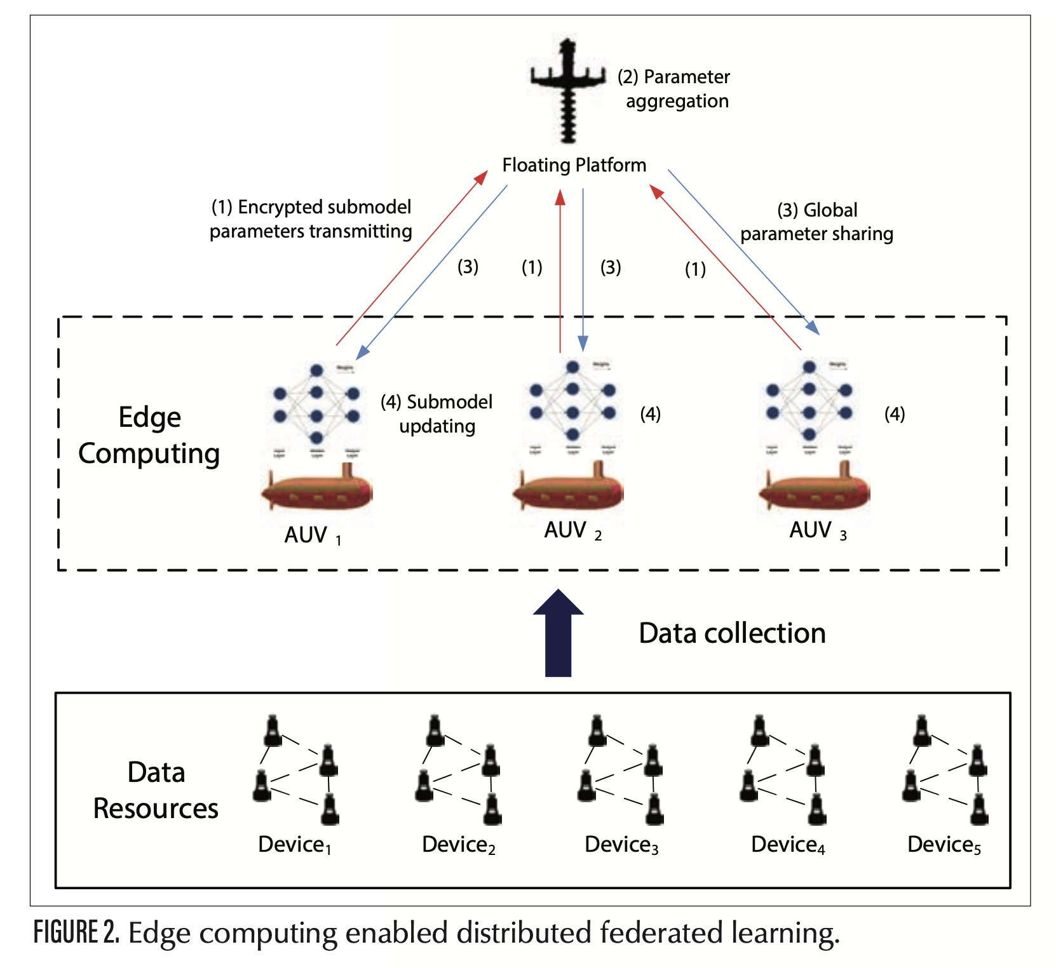

Slide 28
MULTI-AUV-ASSISTED INFORMATION COLLECTION FOR MISSION-CRITICAL IOUT
As aforementioned, multi-AUV-assisted cooperative information collection and transmission is crucial for mission-critical IoUT. Mission-critical IoUT needs to perceive the underwater physical environment in real time to provide timely and effective information for intelligent decision making and control. However, different from the terrestrial IoT relying on radio communication, the low underwater transmission rate and AUV movement speed seriously challenge the stringent timeliness requirements of mission-critical IoUT. Therefore, we intro- duce our recent work to solve this issue, that is, an age of information (AoI, an indicator of the fresh- ness of information [14]) oriented multi-AUV-assisted information collection scheme [15].
As shown in Fig. 3, we have two kinds of AUVs, specifically, H-AUV and V-AUV. H-AUV moves horizontally to collect data from IoUT devices deployed in the seabed or floated in the seawater and relays the collected information to the V-AUV, while V-AUV moves vertically to transmit the information sent by H-AUV to the floating platform. This method can reduce the frequent floating and diving movement of H-AUV for providing uninterrupted time-efficient information collection and alleviating energy consumption. Moreover, the information collection process can be modeled as a limited-service vacation queueing system. Considering the timeliness requirements of mission-critical IoUT, peak AoI is adopted to measure the freshness of information, referring to the time elapsed since the generation time of the latest received packets update at the destination. Fur- thermore, by jointly considering AUVs’ trajectories and the upper limit of the queueing length, the system’s peak AoI is minimized under the energy constraints. Figure 4 shows the peak AoI vs. arrival rate ~ of H-AUVs. We can see that the proposed scheme with the adaptive algorithm is better than the multi-AUV schemes without an adaptive algorithm in terms of peak AoI. With the increase of the arrival rate ~, the systems are overloaded with- out an adaptive algorithm (i.e., M = 3, 4, 5), while the proposed scheme with the adaptive algorithm is stable all along and with minimal peak AoI.

Slide 30
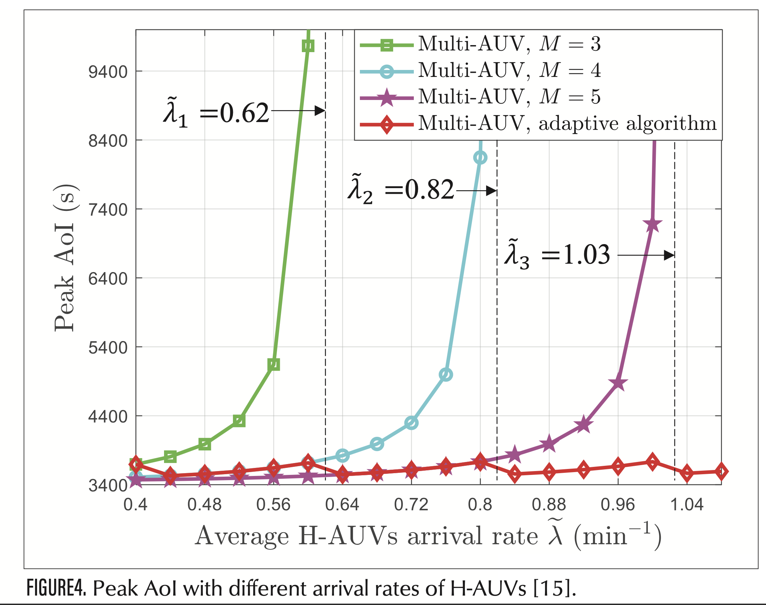

Slide 31
chALLenges And oPen Issues
RELIABLE MULTIHOP TRANSMISSION CONTROL PROTOCOL:
Since most of the data must be transmitted in a multihop manner in mission-critical IoUT, the fad- ing, noise, and interference in the marine envi- ronment will seriously threaten the reliability of communication, making it difficult to meet the requirements of mission-critical IoUT. Therefore, it is essential to comprehensively consider the fac- tors of fairness, security, and data rate to conceive a highly reliable multihop transmission control protocol for large-scale heterogeneous networks. To deal with such a large-scale control decision optimization problem, reinforcement learning, which is good at learning in a complex environ- ment, is a good choice.
ADAPTIVELY ADJUSTED ENCRYPTION AND CODING SCHEME:
Constrained by the contradiction between lim- ited resources and high security and reliability requirements of mission-critical IoUT, it is neces- sary to study an encryption and coding scheme with low resource occupancy. Supervised learning is satisfactory to realize an adaptively adjusted encryption and coding scheme according to the real-time channel characteristics, and recognize attack behaviors to ensure both the security and reliability requirements.

Slide 32
QOS-AWARE COGNITIVE MAC PROTOCOL DESIGN:
As aforementioned, UAC is the most commonly used information transmission approach under- water, but its long and time-varying propagation latency greatly challenges the medium access control (MAC) protocol design. Most of the lit- erature on MAC protocol design is devoted to reducing the influence of long propagation laten- cy. Nevertheless, for mission-critical IoUT, it is essential to take the quality of services (QoS) into consideration. However, the limitation of com- munication resources makes it difficult to satisfy the QoS requirements of mission-critical IoUT. Fortunately, it has been noted that long propa- gation latency and its spatiotemporal uncertainty can allow multiple transmissions to exist simul- taneously in underwater acoustic media without collision and conflict, which opens up the possi- bility of spectrum sharing. Therefore, using ML to conceive a cognitive MAC protocol, which allows multiple nodes to access the same channel at the same frequency and the same time, can intensely improve the utilization of channel bandwidth.

Slide 33
concLusIons

Slide 34
To enable advanced marine activities, in this article, we present the concept of mission-critical IoUT and highlight its key features as well as challenges. Furthermore, we construct a future maritime network architecture for mission-critical IoUT, which can meet the stringent demands and collaborate well with terrestrial networks and space-air networks. Moreover, since the traditional model-driven network techniques rely on a deterministic method, they are unable to cope with the complex underwater environment featuring time-varying, nonlinear, large-scale, and sparse characteristics. Therefore, ML, which has strong capability in dealing with nonlinear and time-varying problems in complex environments, is employed to conceive the brand new design of network techniques for mission-critical IoUT, in terms of effective and fault-tolerant information sensing, reliable and low-latency transmission, as well as reliable and fast processing, respectively. Then we introduce our recent work on reliable and timely transmission, that is, AoI-oriented multi-AUV-assisted information collection. Finally, we envision the open issues and challenges that should be addressed in the future to exploit mission-critical IoUT. We hope that this article facilitates researchers to understand the challenges and potential research trends, and stimulate research interest in mission-critical IoUT.
In the future, we plan to conduct further in-depth research on maritime network architecture, including network protocol fusion with terrestrial networks, satellite networks, as well as air networks for improving the interoperability in the future network. Moreover, considering the wide- spread maritime radar systems and broadcasting systems, we are inspired to explore the coexis- tence paradigms with maritime radar systems and broadcasting systems for enhancing the utilization of both spectrum resources and infrastructures.

Slide 35
REFERENCES

Slide 36
[1] T. Qiu et al., “Underwater Internet of Things in Smart Ocean: System Architecture and Open Issues,” IEEE Trans. Industrial Informatics, vol. 16, no. 7, 2019, pp. 4297–4307.
[2] J. Wang et al., “Thirty Years of Machine Learning: The Road to Pareto-Optimal Wireless Networks,” IEEE Commun. Sur- veys & Tutorials, vol. 22, no. 3, 2020, pp. 1472–1514.
[3] C.-C. Kao et al., “A Comprehensive Study on the Internet of Underwater Things: Applications, Challenges, and Channel Models,” Sensors, vol. 17, no. 7, 2017, p. 1477.
[4] M. Xu and L. Liu, “Sender-Receiver Role-Based Energy-Aware Scheduling for Internet of Underwater Things,” IEEE Trans. Emerging Topics in Computing, vol. 7, no. 2, 2019, pp. 324–36.
[5] Q. Wang et al., “On Connectivity of UAV-Assisted Data Acquisition for Underwater Internet of Things,” IEEE Internet of Things J., vol. 7, no. 6, 2020, pp. 5371–85.
[6] Z. Zhou et al., “E-Carp: An Energy Efficient Routing Protocol for UWSNs in the Internet of Underwater Things,” IEEE Sen- sors J., vol. 16, no. 11, 2016, pp. 4072–82.
[7] O. Gupta et al., “Underwater Networked Wireless Sensor Data Collection for Computational Intelligence Techniques: Issues, Challenges, and Approaches,” IEEE Access, vol. 8, 2020, pp. 122,959–74.
[8] S. Guan et al., “MagicNet: The Maritime Giant Cellular Net- work,” IEEE Commun. Mag., vol. 59, no. 3, Mar. 2021, pp. 117–23.
[9] W. Liu et al., “A Survey of Deep Neural Network Architec- tures and Their Applications,” Neurocomputing, vol. 234, 2017, pp. 11–26.
[10] X. Deng et al., “Data Fusion Based Coverage Optimization in Heterogeneous Sensor Networks: A Survey,” Info. Fusion, vol. 52, 2019, pp. 90–105.
[11] J. Feng et al., “Cooperative Computation Offloading and Resource Allocation for Blockchain-Enabled Mobile-Edge Computing: A Deep Reinforcement Learning Approach,” IEEE Internet of Things J., vol. 7, no. 7, 2020, pp. 6214–28.
[12] X. Hou et al., “Reliable Computation Offloading for Edge-Computing-Enabled Software-Defined IoV,” IEEE Inter- net of Things J., vol. 7, no. 8, 2020, pp. 7097–7111.
[13] Q. Yang et al., “Federated Machine Learning: Concept and Applications,” ACM Trans. Intelligent Systems and Technolo- gy, vol. 10, no. 2, 2019, pp. 1–19.
[14] M. A. Abd-Elmagid, N. Pappas, and H. S. Dhillon, “On the Role of Age of Information in the Internet of Things,” IEEE Commun. Mag., vol. 57, no. 12, Dec. 2019, pp. 72–77.
[15] Z. Fang et al., “AoI Inspired Collaborative Informa- tion Collection for AUV Assisted Internet of Underwater Things,” IEEE Internet of Things J., 2021. DOI: 10.1109/ JIOT.2021.3049239.

